Slide 1

รายงานความคืบหน้า 0.3
Notes:
<number>

Slide 2
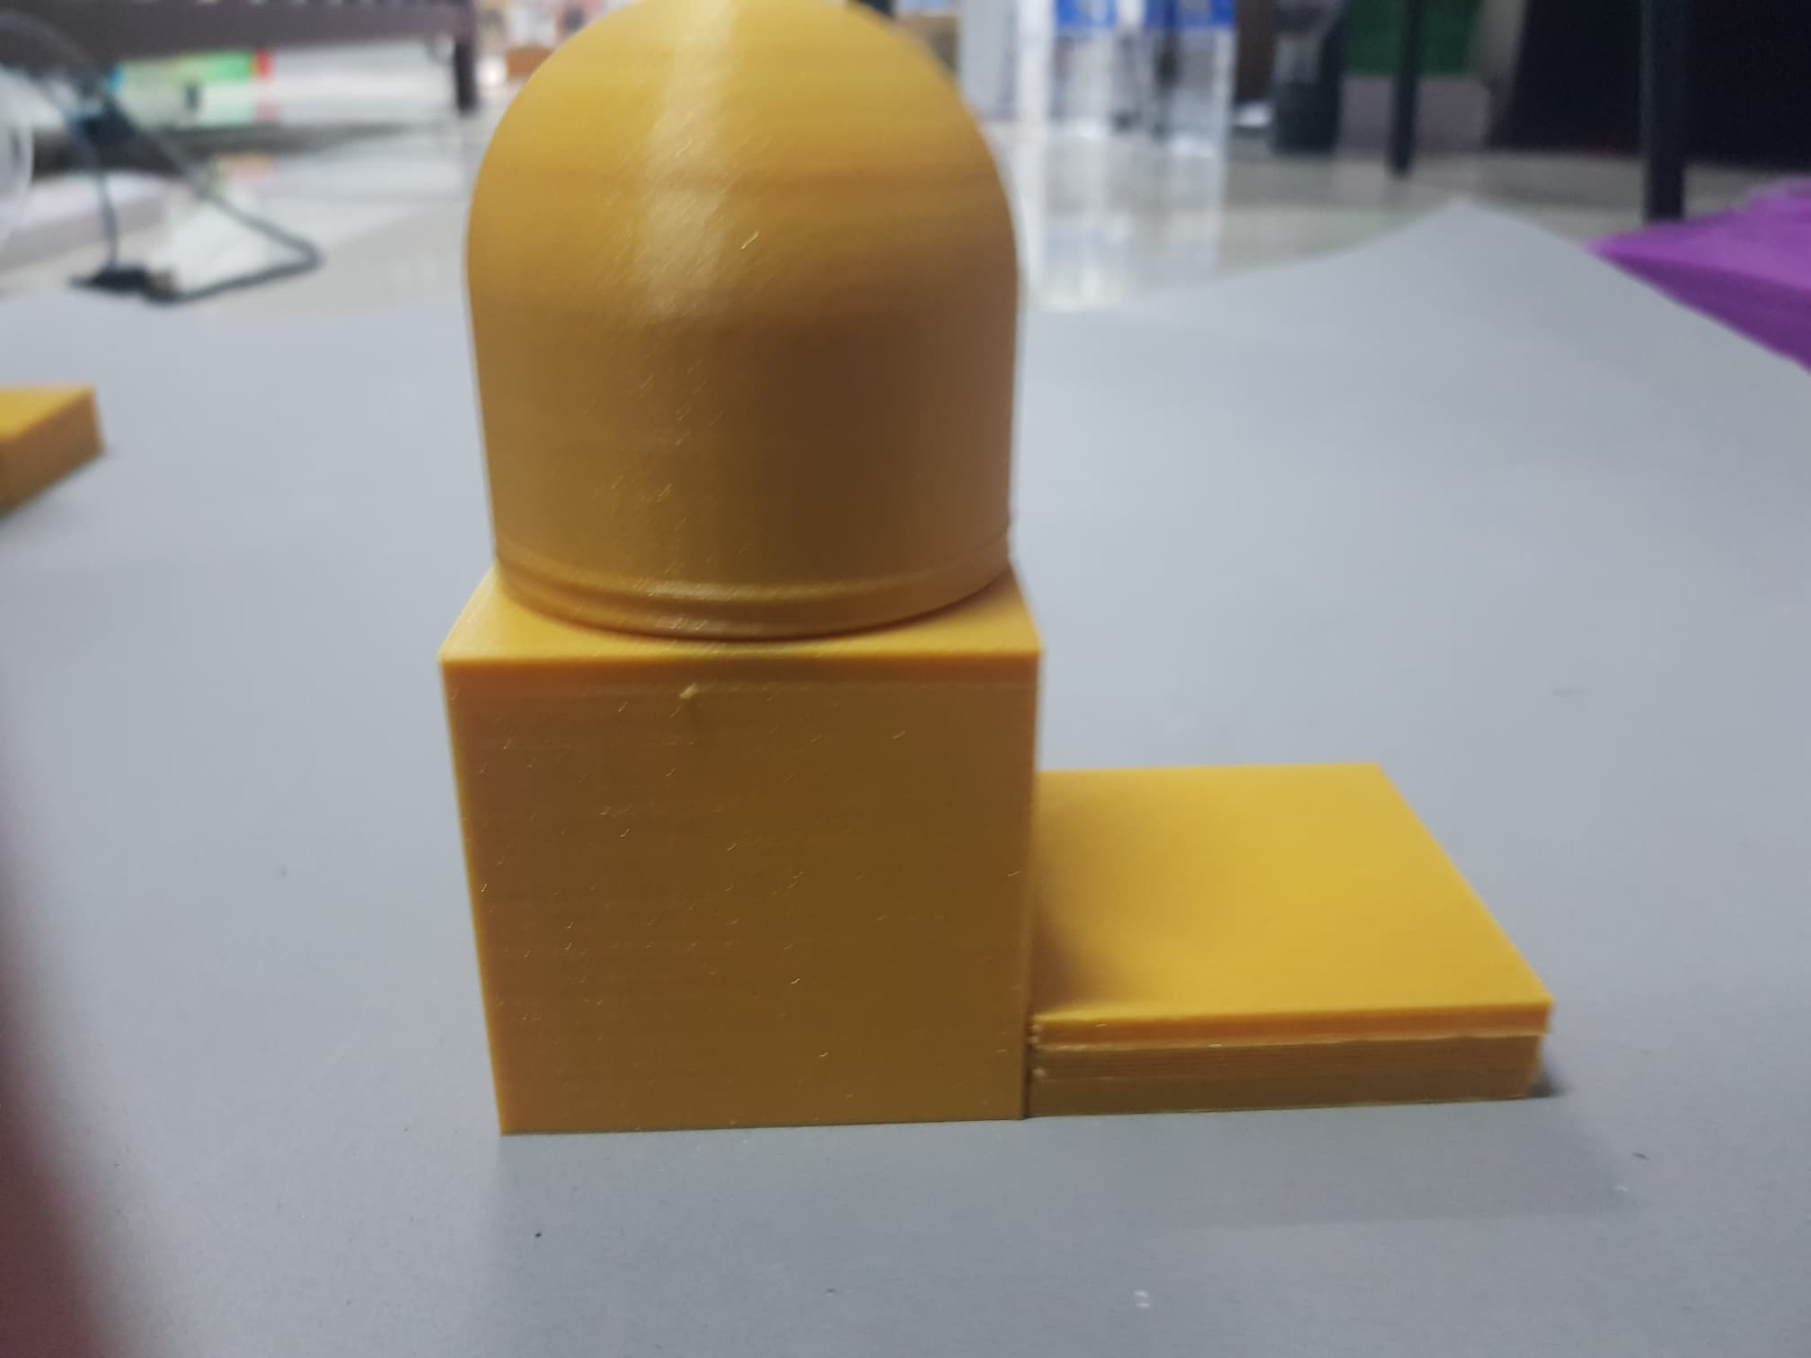
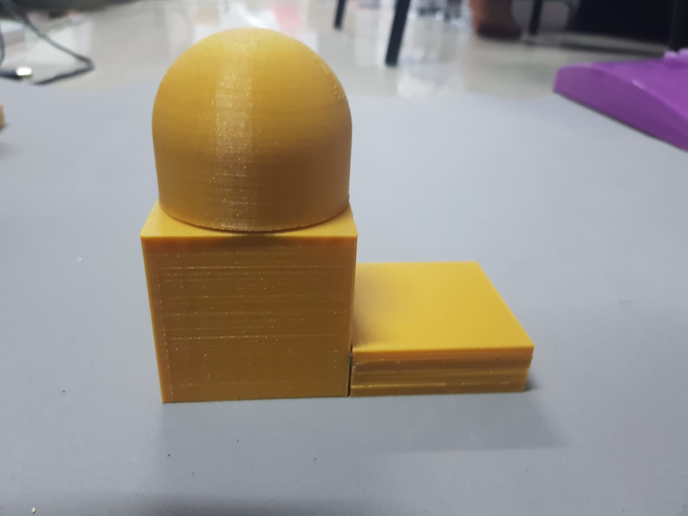
Assemble object
Side View
Object 1 High Dome
Object 2 Low Dome
Notes:
<number>

Slide 3
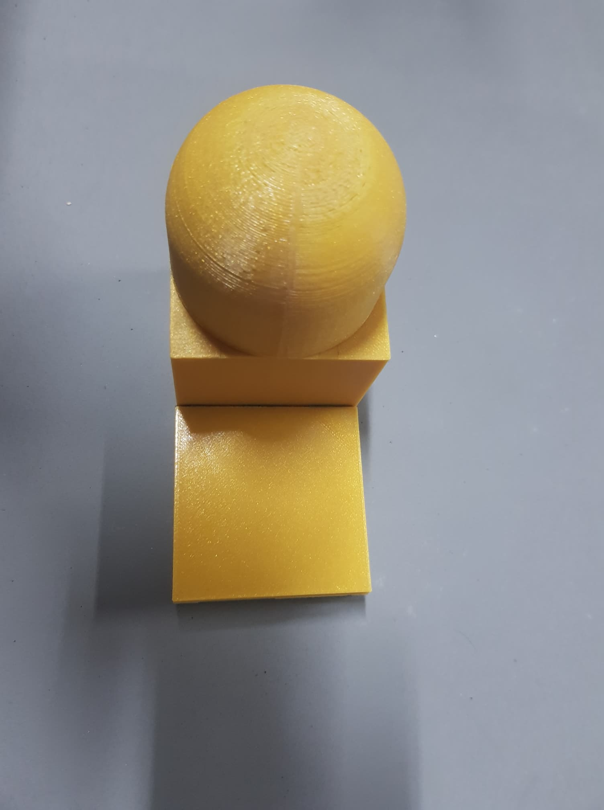
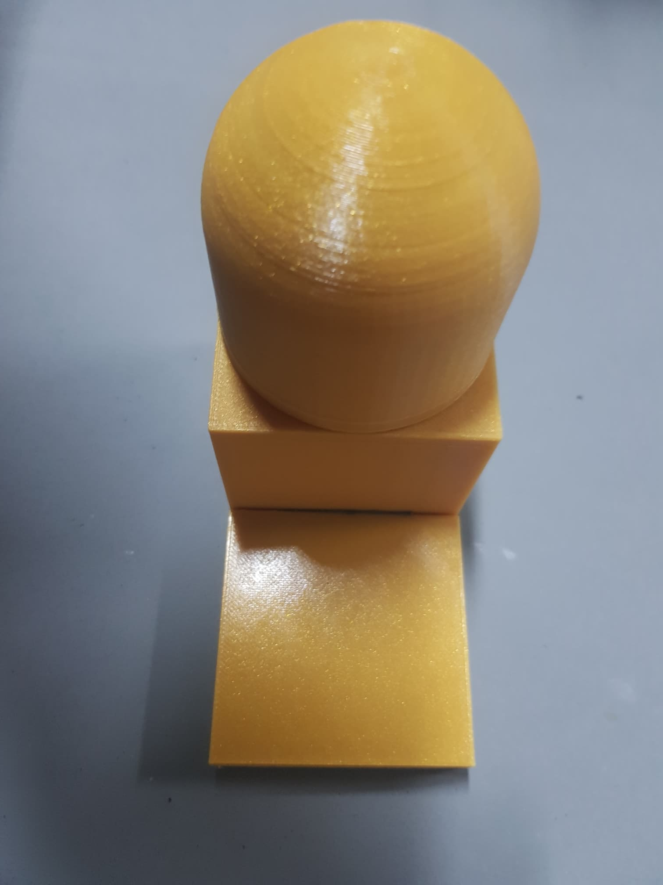
Assemble object
Front View
Class 1 High Dome
Class 2 Low Dome
Notes:
<number>

Slide 4
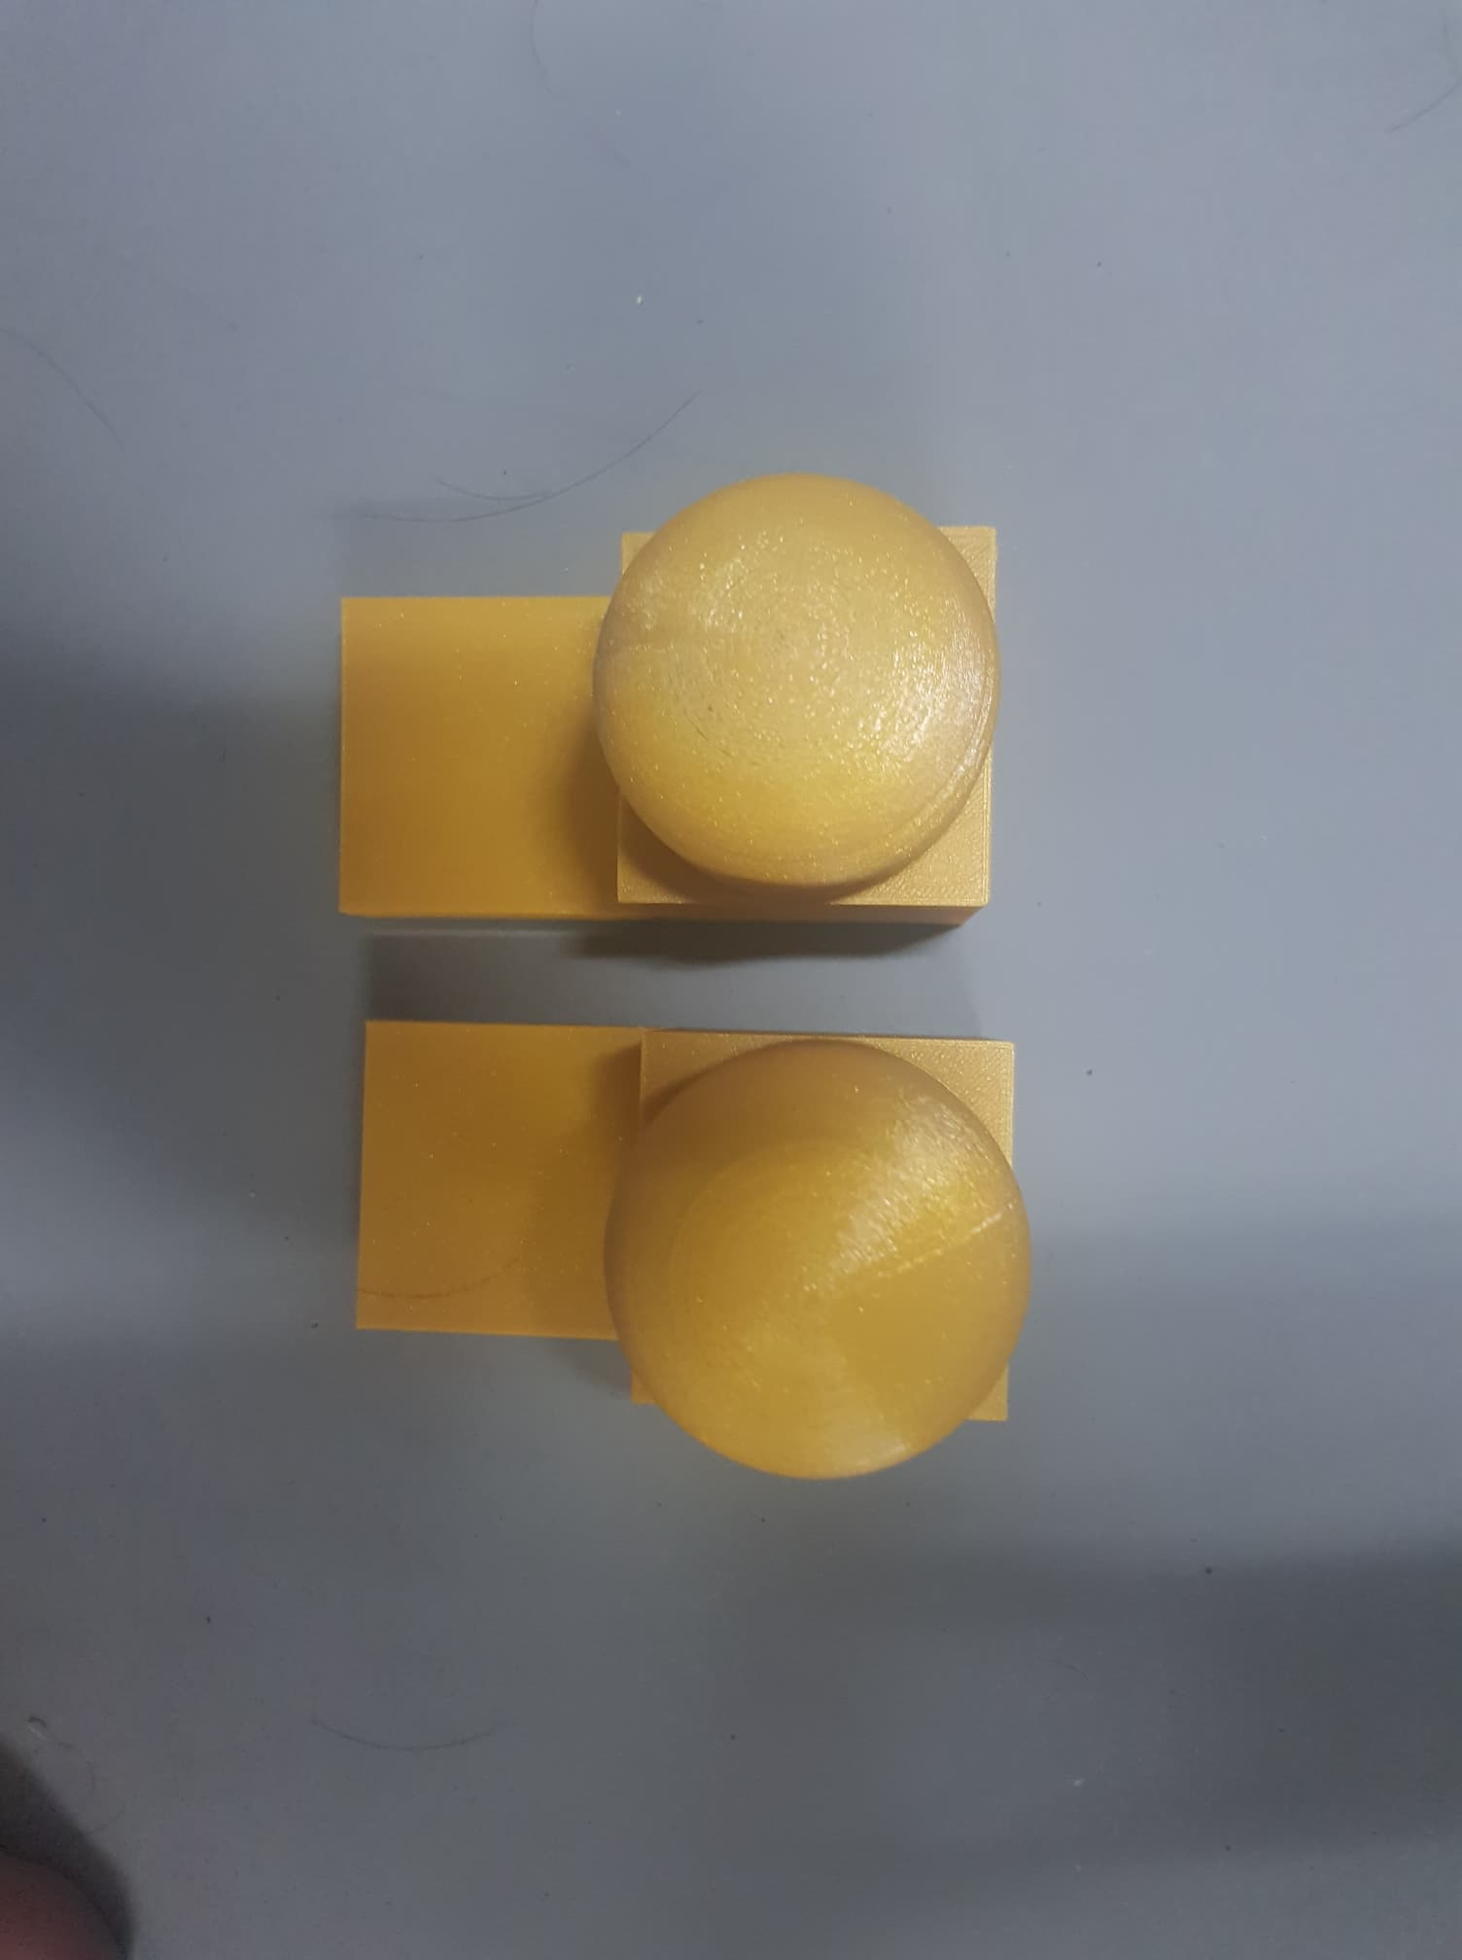
Assemble object
Top View

Slide 5
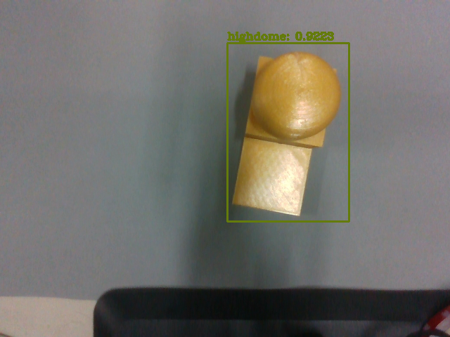
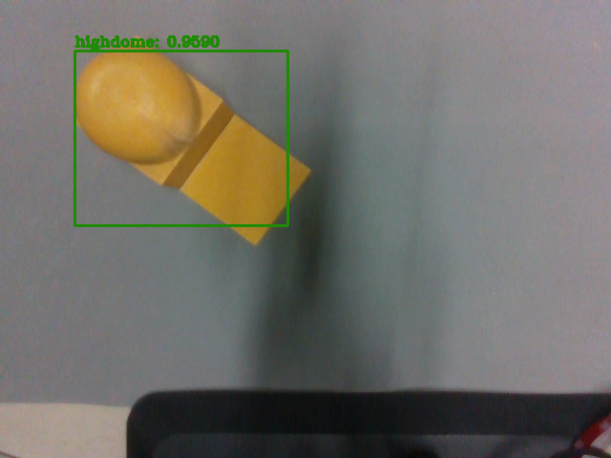
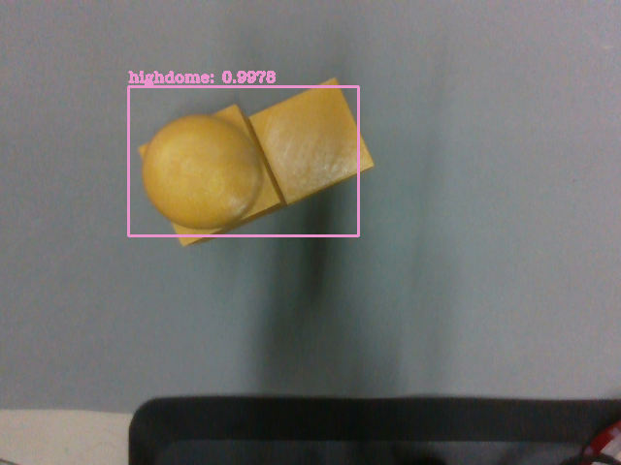
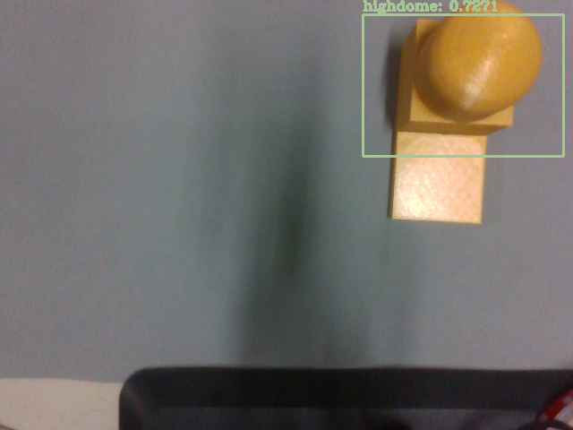
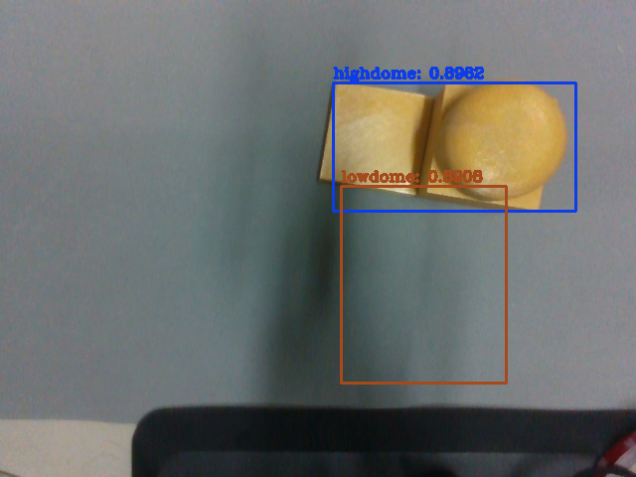
RGB performance test
Notes:
<number>

Slide 6
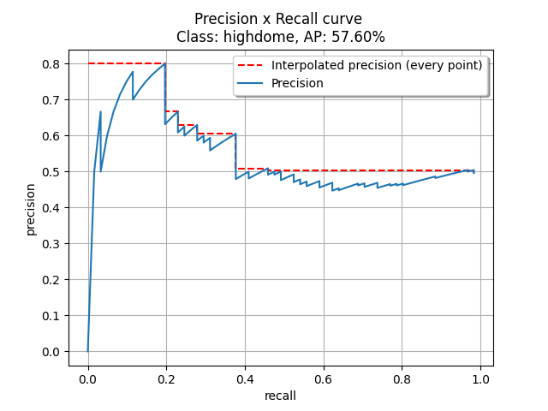
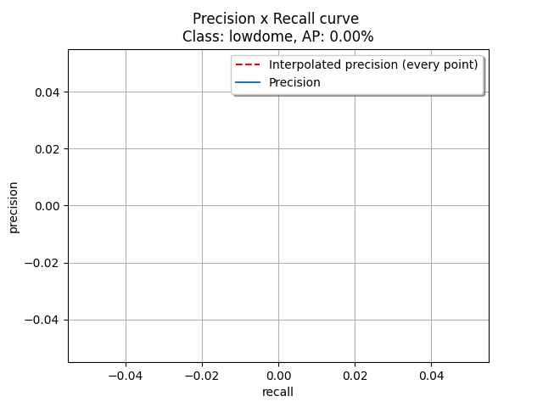
RGB performance test
Class High Dome
Class Low Dome
mAP= 28.80%

Slide 7
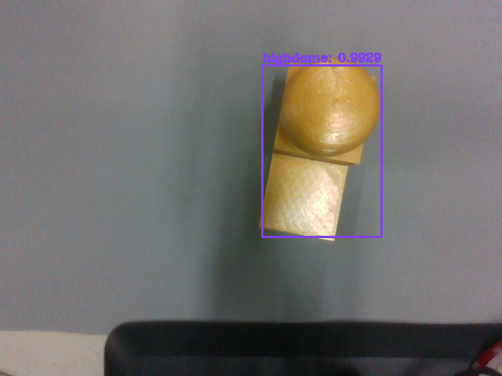
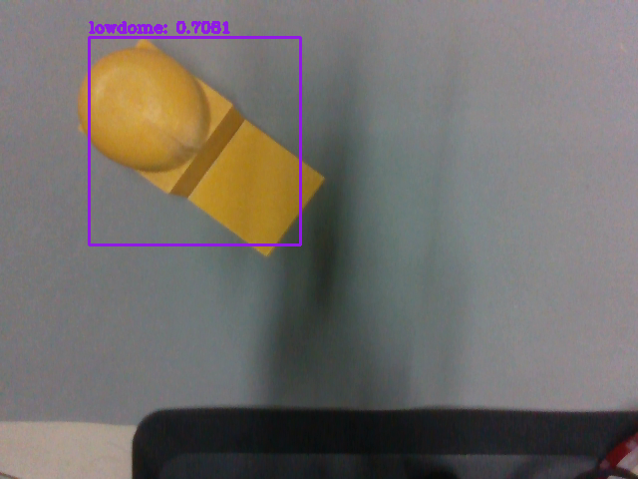

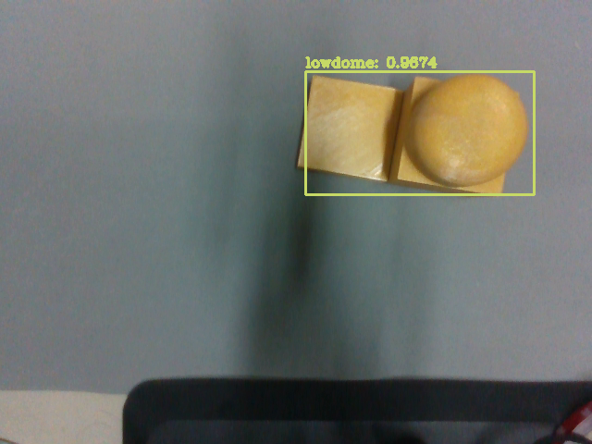
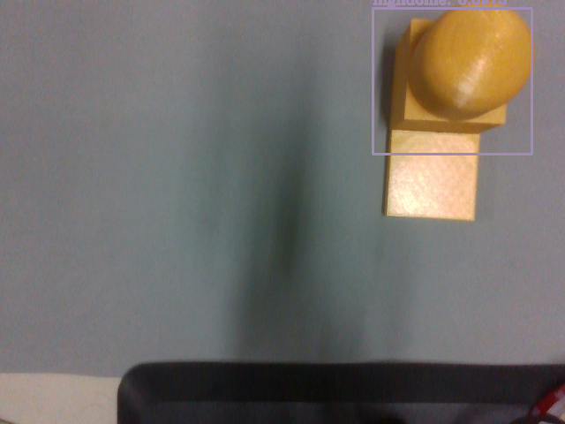
RGBD performance test
Notes:
<number>

Slide 8
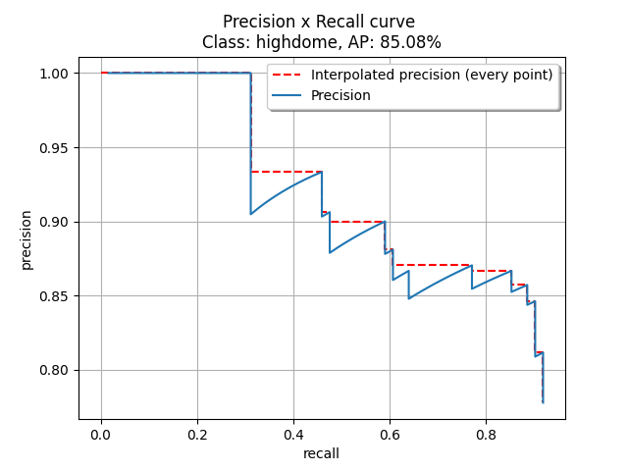
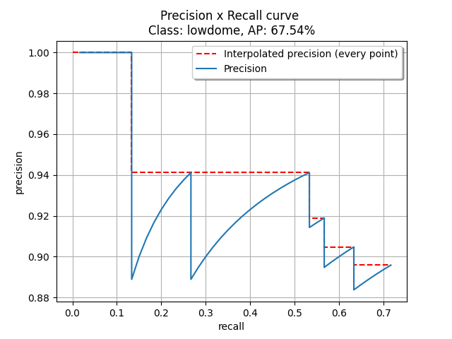
RGBD performance test
Class High Dome
Class Low Dome
mAP=76.31%

Slide 9
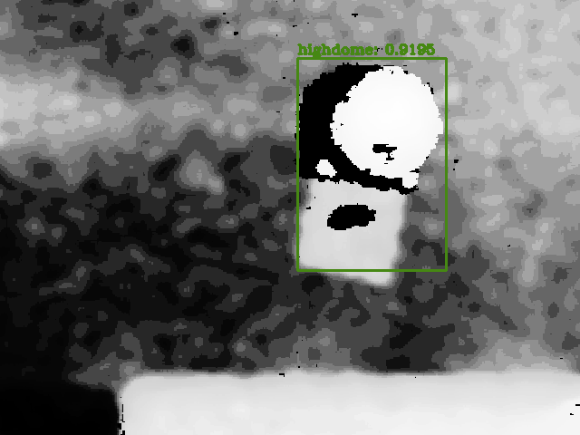
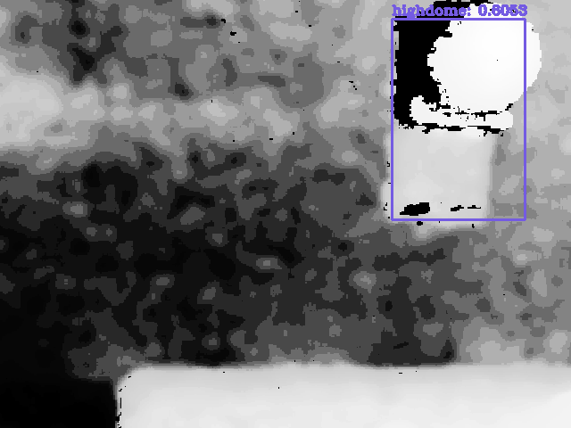
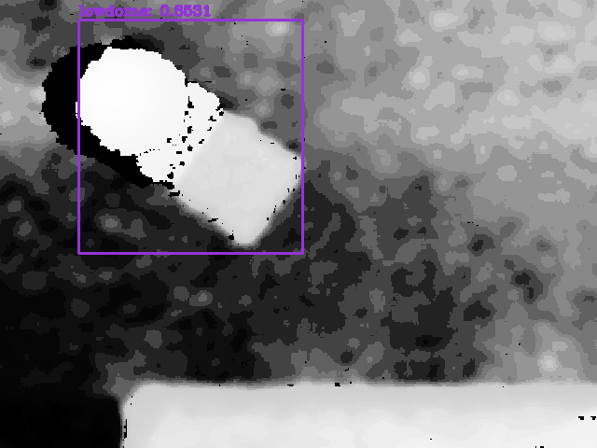
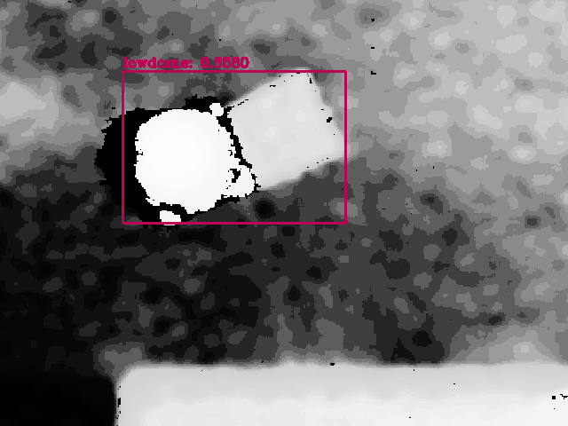
Depth map performance test
Notes:
<number>

Slide 10
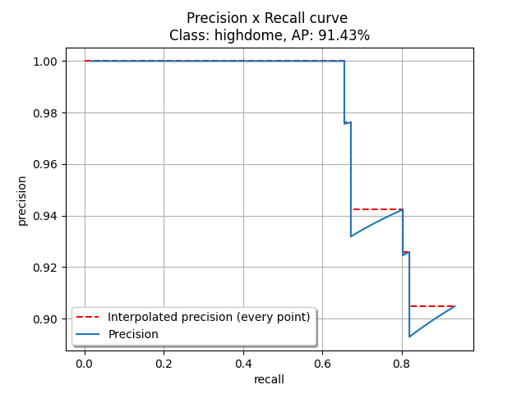
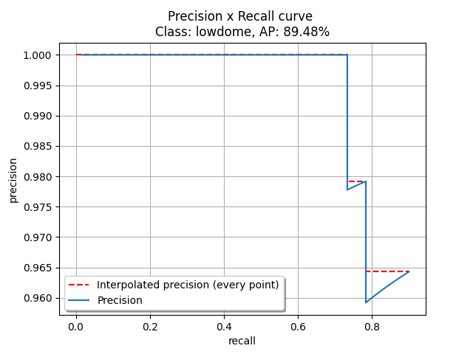
Depth map performance test
Class High Dome
Class Low Dome
mAP=90.46%

Slide 11
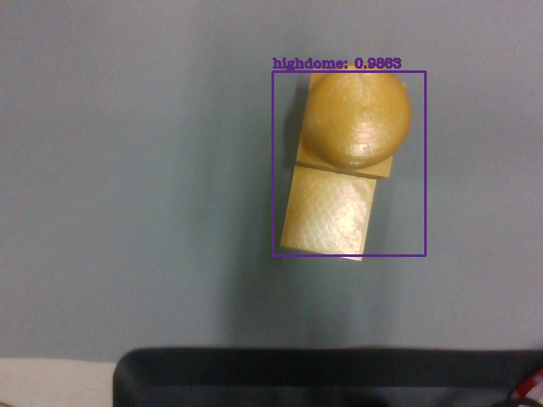

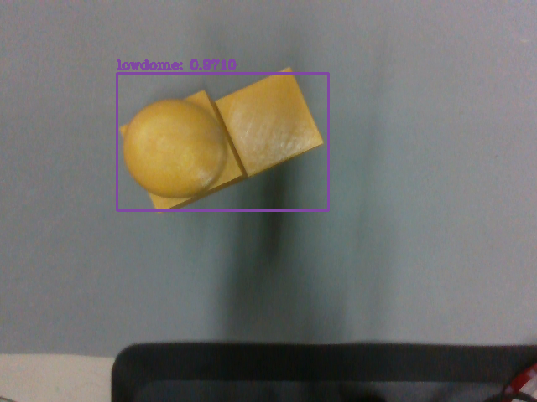
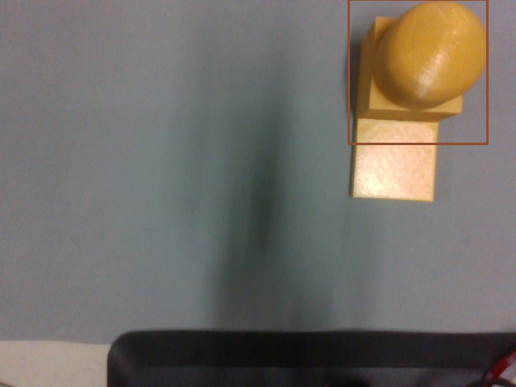
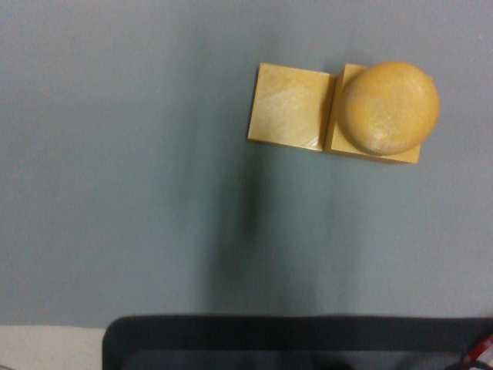
RGBD filter performance test
Notes:
<number>

Slide 12
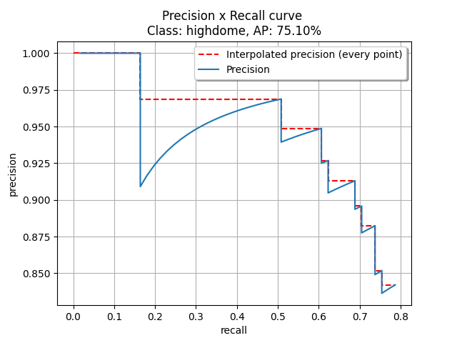
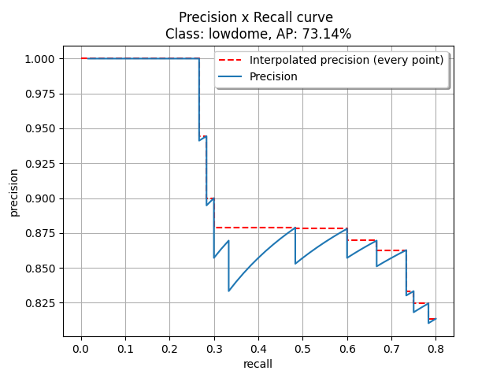
RGBD filter performance test
Class High Dome
Class Low Dome
mAP=74.12%

Slide 13
Conclusion
 | RGBD | RGB | Depth map
High Dome | 85.08% | 57.60% | 91.43%
Low Dome | 67.54% | 0.00% | 89.48%
mAP | 76.31% | 28.8% | 90.46%

